Slide 1




Formula 1 Drivers
Performance Analysis
By Timur Mukashev
Notes:
My name is Timur Mukashev, I am a data analyst transitioning from a background in Supply Chain - Logistics. I got into data analytics because I always wanted to see bigger picture of data flow.

Slide 2

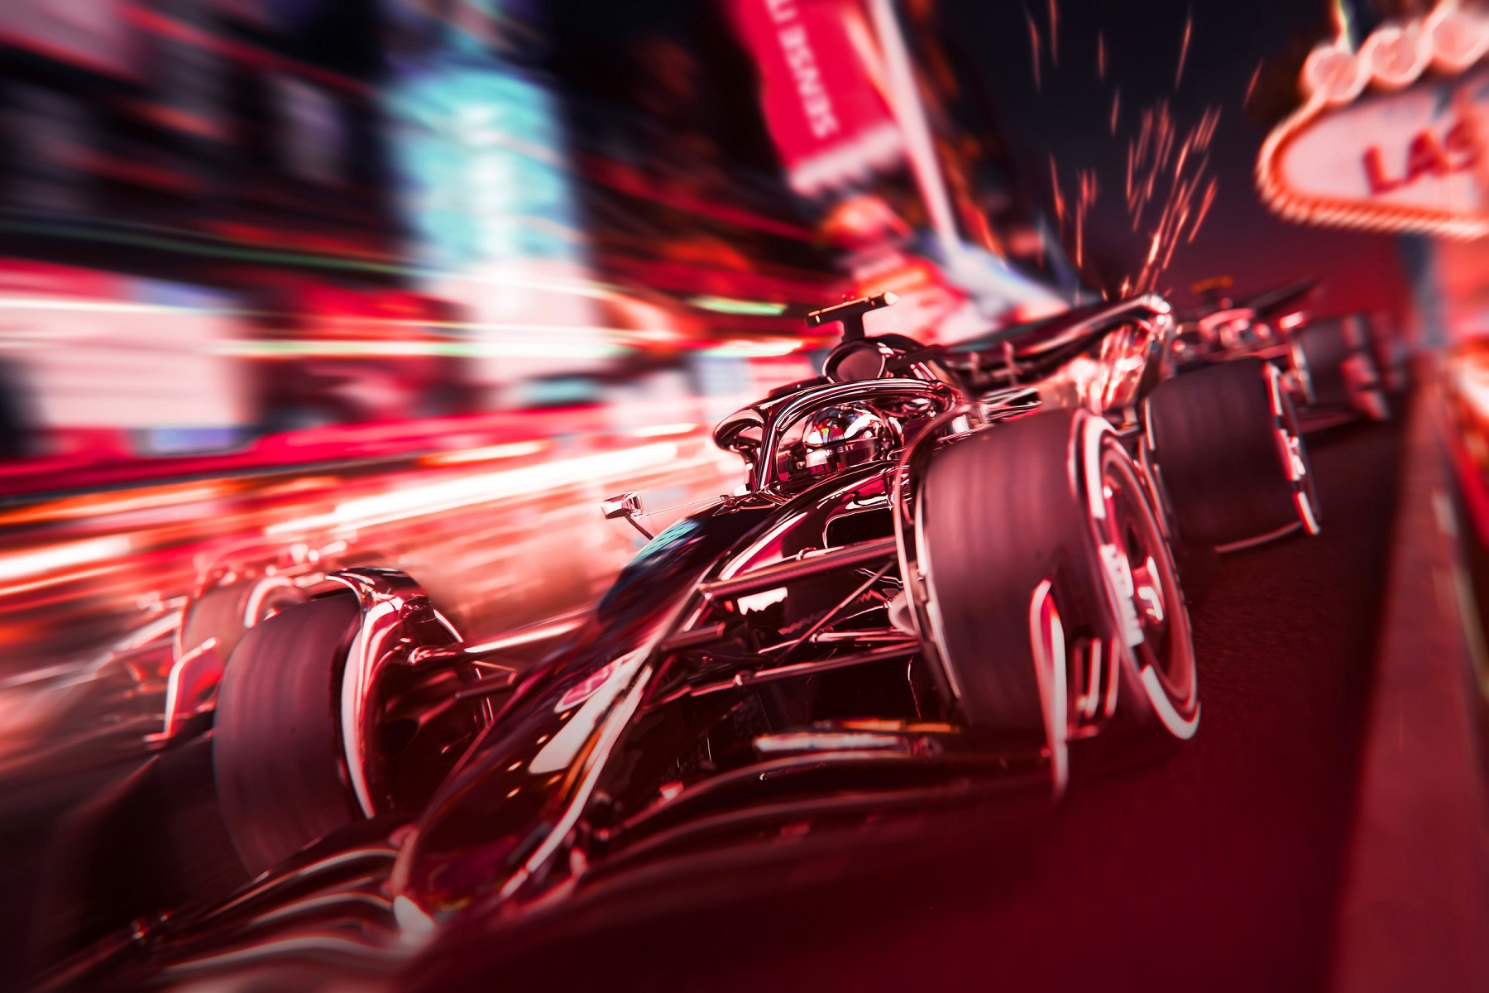
TABLE OF CONTENT
Introduction
Performance Metrics
Winning Teams Over the Years
Qualifying Performance
Drivers' Performance Based on Pole Positions and Wins
Conclusion

Slide 3
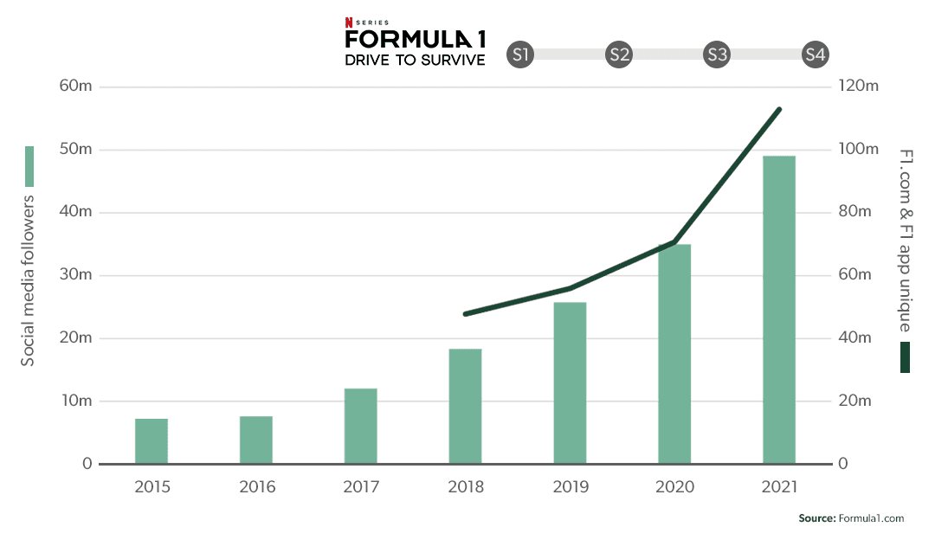
Introduction
Overview of Formula 1 and its global popularity.
Importance of analyzing driver performance for teams and fans.
Key factors that contribute to a driver's performance.
Notes:
Formula One is one of the most popular and prestigious motorsports in the world
The 2022 F1 World Championship season ended as the most-viewed ever on American television, hitting 1.21 million viewers per race. You can see it in the bar chart the increase of viewers of the Netflix Series “Drive to Survive”. It shows interest of people outside this sport as well.
Today I would like to focus on Driver's performance which plays a critical role in contract negotiations. There are two main factors to be considered: how a driver's performance in the previous season influences their contract extension for the next year, and whether training and retaining the same drivers for longer periods of time with the same team provides any advantage in the constructor's championship.
There are various factors that affect a driver's contract extension, including their on-track performance, consistency, adaptability, experience, and ability to work with their team.
That’s why I have decided to obtain the performance analysis of Formula 1 drivers. And for this I used various data sets from Kaggle.

Slide 4


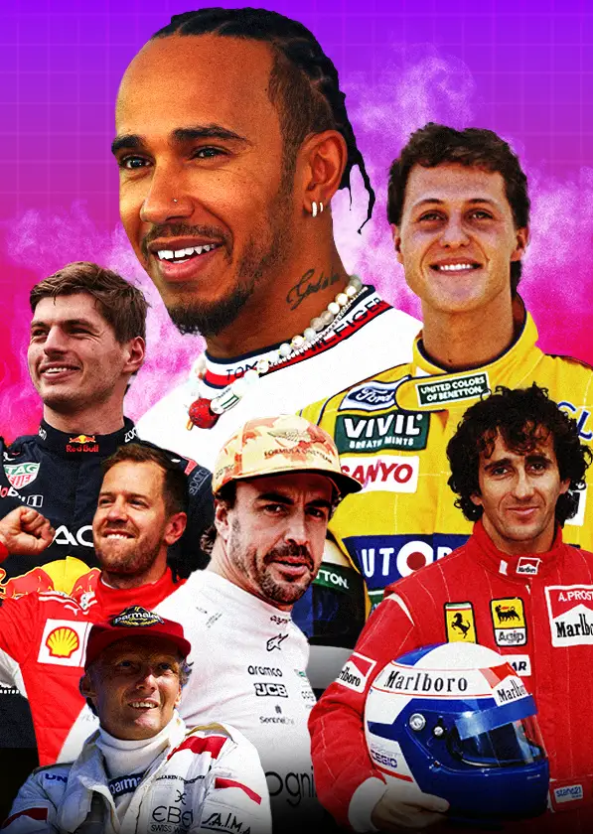
Performance Metrics
Key performance metrics:
Qualifying position
Race results
Fastest laps
Points earned
Notes:
Qualifying position, Race results, Fastest laps, Points earned, these are key performance metrics which have reflects on different aspects of a driver's performance. In most of the cases Qualifying position has a huge impact on the Race result, if we exclude some factors like weather condition for example. In some races Qualification of the drivers can predict the race result, as it is extremely difficult to over take in tiny, city roads. One of the main goals is earn points by winning races, setting the fastest laps.
I also need to highlight the importance of consistency and adaptation to various track conditions is another critical aspect for Formula 1 drivers’ performance.

Slide 5

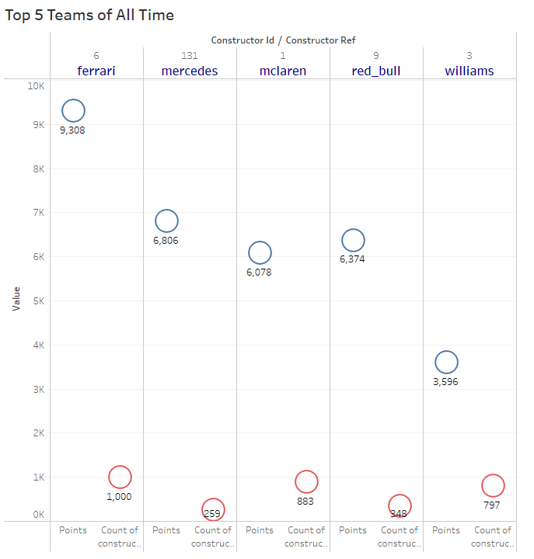
Winning Teams Over
the Years
Significant role of teams' dominance played some Legendary drivers like Michael Schumacher, Niki Lauda, Lewis Hamilton, Sebastian Vettel, Kimi Raikkonen, Fernando Alonso, and of course current champion Max Verstappen.
Notes:
We can see in a graph The Top 5 teams of all time, which are Ferrari, Mercedes, McLaren, Red Bull & Williams. It is identified by total # of points earned by drivers and total # of points earned by constructors.
Significant role of teams' dominance played some Legendary drivers like Michael Schumacher, Niki Lauda, Lewis Hamilton, Sebastian Vettel, Kimi Raikkonen, Fernando Alonso, and of course current champion Max Verstappen.
In this visualization we can see main factors brings teams to the top of the list.

Slide 6
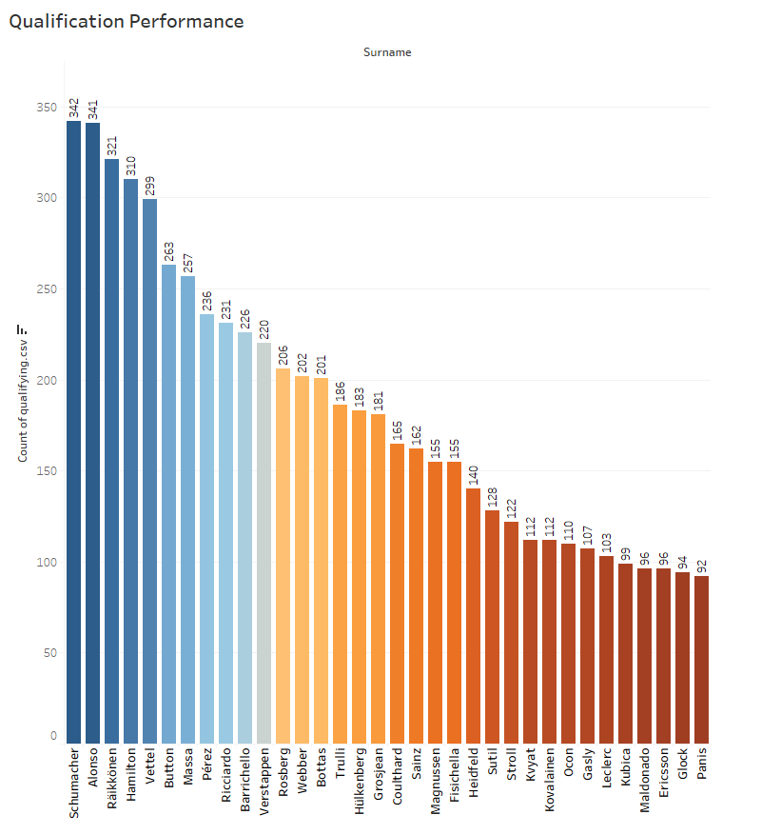
Qualifying Performance
Significance of qualifying rounds in determining race starting positions.
Graphs shows overall statistic of qualifying positions, which has direct correlation with race wins
Notes:
I cannot avoid importance of the qualifying performance. As it was mentioned earlier, qualifying rounds determine race starting positions and in most of the cases can determine race results.
You can see graphs shows overall statistic of qualifying positions, which has direct correlation with race wins, which we will see in next slide

Slide 7
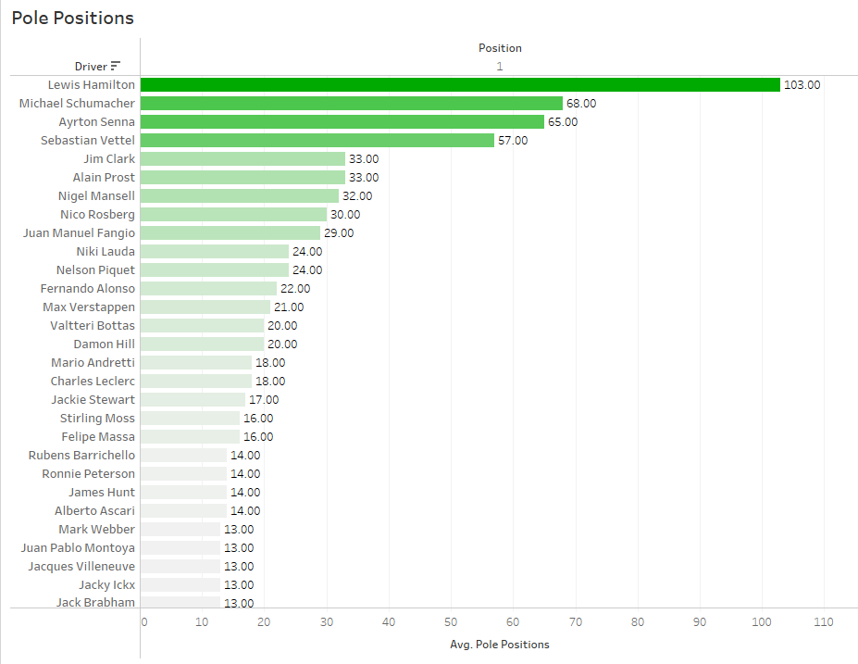
Drivers' Performance Based on Pole Positions and Wins
The top drivers based on their number of pole positions and race wins
Notes:
The bar chart represents the top drivers based on their number of pole positions and race wins
Please note that the chart does not consider race results of the current year.
We can see the dominance of 7-time World Champion Lewis Hamilton. Following by the first 7-time World Champion – Michal Schumacher.
Taking into consideration visualization shown earlier, we can say that the consistency of these drivers made them the best of all time.

Slide 8


Conclusion
Driver's success critical metrics and its correlation
Future work analysis
Notes:
In conclusion, the analysis of Formula 1 driver performance underscores the dynamic nature of this sport. I've delved into the critical metrics that shape a driver's success, including qualifying positions, race day results, fastest laps, and points earned. By examining these factors, I gain a deeper understanding of a driver's adaptability, consistency, and strategic skills.
Also, I would like to add that in future work analysis, I am planning to delve into details of the last 4 seasons to obtain some predictions for the season 2025. Hope it will work ☺
Thank you very much for your attention and let’s stay connected!

Slide 9

Thank You!

